Slide 1

Netdisco: 15 years of Modern Perl

Slide 2
“Our understanding of what makes great Perl programs has changed.”
– Modern Perl

Slide 3
SQL
HTML::Mason
Apache
2011
2003
DBIx::Class
Dancer
Plack
Template::Toolkit
Bootstrap
JQuery

Slide 4


Slide 5
@SNMP::Info::Layer2::CiscoSB::ISA
= qw/SNMP::Info::Layer2
SNMP::Info::Entity
SNMP::Info::EtherLike
SNMP::Info::CiscoStats
SNMP::Info::CiscoConfig
SNMP::Info::CDP
Exporter/;

Slide 6
curl -L http://cpanmin.us/
| perl - --local-lib ~/perl5
App::Netdisco

Slide 7


Slide 8
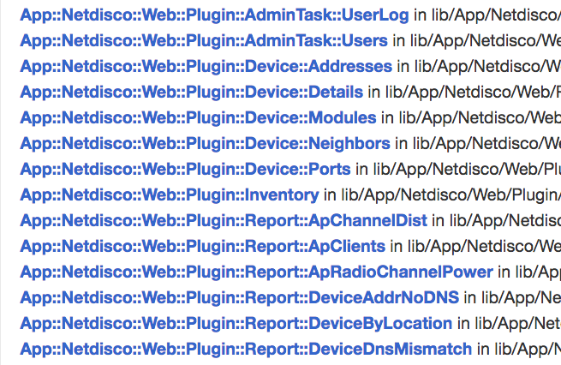

Slide 9
“Perl is a fantastic language for developers.”
– Simon Cozens

Slide 10


Slide 11
2016
W3C Web Components

Slide 12
“Don’t ever make the mistake that you can design something better than what you get from ruthless massively parallel trial-and-error with a feedback cycle.”
– Linus Torvalds

Slide 13


Slide 14
Thanks!

